Slide 1

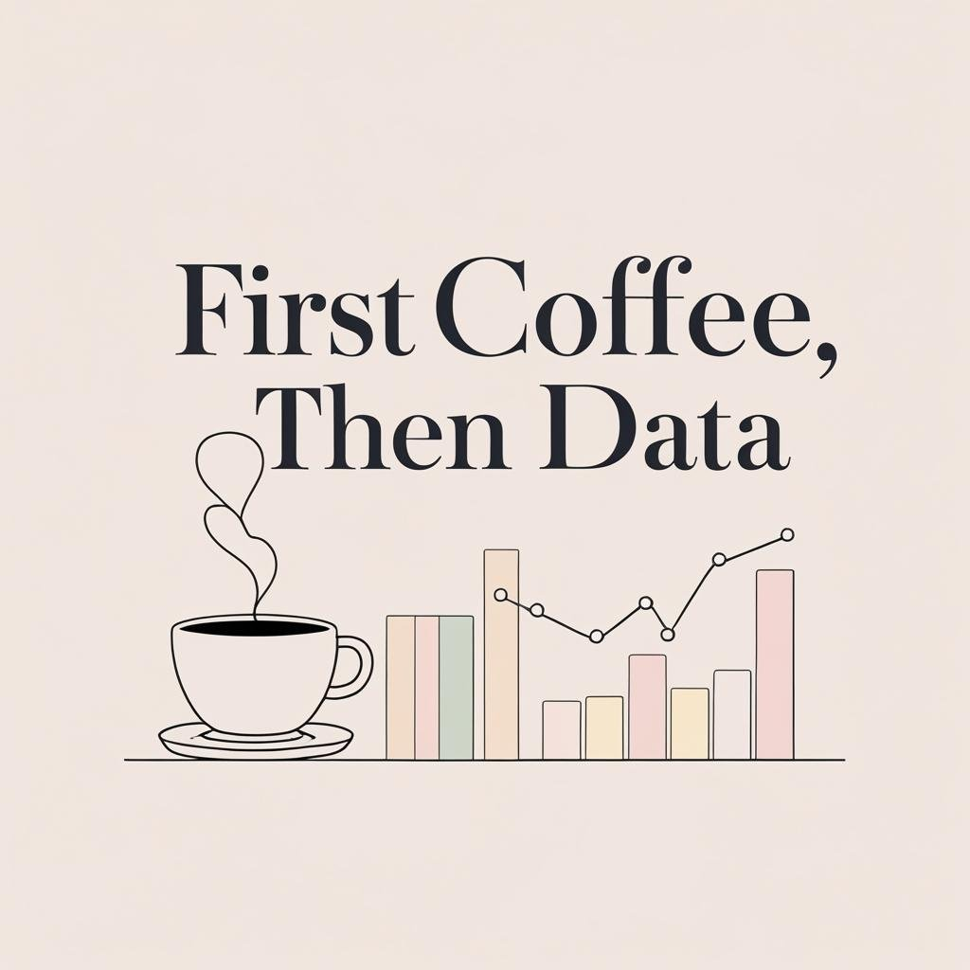
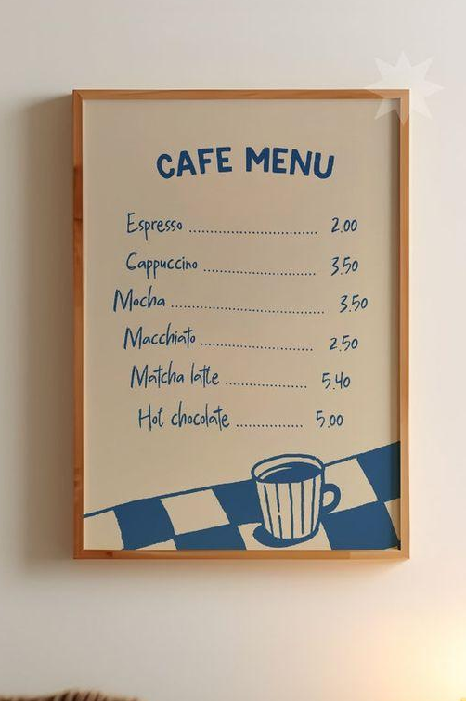




Cafe Sales &
Insights
By Ayema Qureshi and Itzel Sanchez

Slide 2


MEET
THE TEAM
Ayema Qureshi
Project Manager & Python Developer
Itzel Sanchez
Excel Specialist & Data Analyst
Ayema led the Python side of the project, focusing on data cleaning, analysis, and visualizations. She also coordinated timelines, managed collaboration, and ensured all findings aligned across tools.
Itzel handled the Excel portion of the project, building Pivot Tables, identifying trends, and creating dashboards to highlight key insights like the most profitable months and items.

Slide 3
AGENDA
1
INTRODUCTION
2
CLEANING PROCESS
3
KEY FINDINGS
4
RECOMMENDATIONS
5
REFLECTIONS

Slide 4
BUSINESS
OBJECTIVES
1
2
3
OBJECTIVE
OBJECTIVE
OBJECTIVE
Identify the Busiest and Most Profitable Times
Uncover General Sales Trend
Evaluate and Improve Data Quality
Notes:
Objective 1: Identify the Busiest and Most Profitable Times:
Determine which months and days of the week had the most transactions and brought in the highest revenue.
Help the café owner understand when to focus marketing efforts or staffing.
Objective 2: Uncover General Sales Trends
Find patterns in sales, like which items sell the most, what the ideal payment methods are, and whether weekends differ from weekdays.
Offer creative insights to help the business make smarter decisions.
Objective 3: Evaluate and Improve Data Quality
Clean and prepare the messy dataset by handling missing data, fixing incorrect data types, and making the data analysis-ready.
Highlight issues in the dataset (e.g. blanks, errors, unknowns) and explain how they might impact business decisions.

Slide 5
Data Cleaning Summary

Slide 6
Making Sense of Raw Data
Missing Values
Incorrect Data Types
Miscalculations
01
02
03
Multiple fields were missing data from each column, especially in the Location and Payment Method.
The missing values were "blank", "error", and "unknown"
Most of the columns data types were wrong, such as Quantity, Price Per Unit and Grand Total.
Grand Total amounts didn’t always match the item prices
Notes:
Before we could start finding answers, we needed to clean up the original dataset. Like many real-world records, this one wasn’t perfect. Here are some of the issues we found:
Missing Information: A lot of the data was incomplete — especially in columns like location and payment method. This made it harder to analyze certain parts of the business, but we did our best to keep and use as much useful information as possible without throwing things away.**Some of the items have similarities in their PPU , which could have lead to the misleading of popularity or products throughout the year of 2023, so we had to create place holders in order to not eliminate half of valuable data that could lead to the misinterpretation of how much was made within the year of 2023
Mismatched Data Types: Some values that were supposed to be numbers were written in a way the computer couldn’t recognize — almost like trying to add words and numbers together. We fixed these so the system could calculate totals correctly.
Incorrect Totals: In some cases, the grand total (how much a customer paid in total) didn’t match the items and prices listed. We went back and corrected those so the data would reflect what actually happened in the sales.
Cleaning the data like this helps us trust the numbers and draw clearer conclusions for your café.

Slide 7
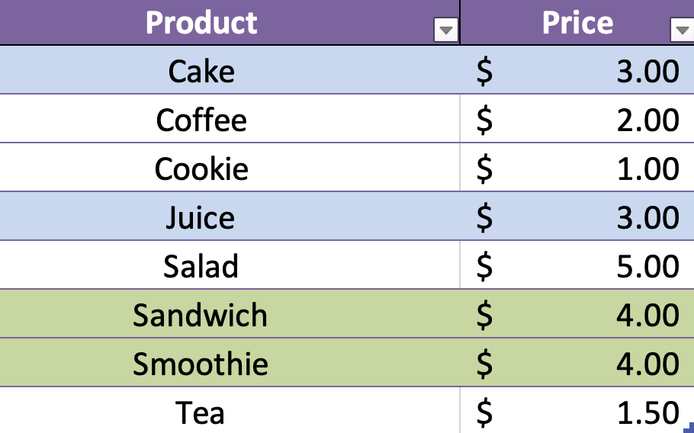
Data Cleaning Journey
Goal
We only deleted rows if they were missing too much information to be useful — otherwise, we kept and fixed what we could.
Step 5
If a row was missing a transaction date, we filled it in using the date from the row above to keep everything in order.
Step 4
If we didn’t know what item was sold, we labeled it as a “mystery item” based on the price — so nothing was left out.
Step 3
We filled in missing quantities, item names, and totals instead of deleting rows. This helped us keep more useful data.
Step 2
We uploaded the cleaned file to GitHub so the next person could continue working in Excel.
Step 1
We used Python to fix the data and fill in missing values — making sure prices and numbers were in the right format for analysis.
Notes:
Before we could pull any insights from the café’s data, we had to make sure it was clean, complete, and usable.
FIrst, I used Python to clean and organize the data. We made sure numbers like prices were in the correct format, and we filled in any missing or incorrect values with “NaN,” which just means the data is missing — so it won’t mess up our calculations for analysis later on.
Once i went through my cleaning process through python, my next step was to upload it to github, so itzel can continue working on cleaning process on Excel
Once my partner Ayema shared her clean file . I was tasked with correcting all missing column in items , quantity , pricing and grand totals within each day , instead of deleting rows with missing info, I did my best in finding the missing values using this index created right here (Bottom corner).
As you can see there are products that contain repeated pricing amounts making it difficult to really find how much of an item, someone had brought so i replaced all repeated blanks in the item column with “mystery item”. So that it still counted in our analysis, even if the exact name was unknown.
And lastly, for missing transaction dates, Itzel used a smart approach. If a row didn’t have a date, but the row above it did, we just filled it in with that same date. That helped keep the timeline in order when we looked at monthly trends.
Our goal was to keep as much relevant data as possible, so When we did delete data:
We only removed rows when they were clearly unusable. For example, if there was had no payment method, or no location listed and also there were multiple other missing values (like no item name or quantity), then we dropped it.
Otherwise, we kept the data and tried to make the most of it. We kept as much data as we could to get a much clearer representation on the revenue that has been made for the year 2023

Slide 8
Key Findings
Notes:
Next, we will be going over our key findings

Slide 9
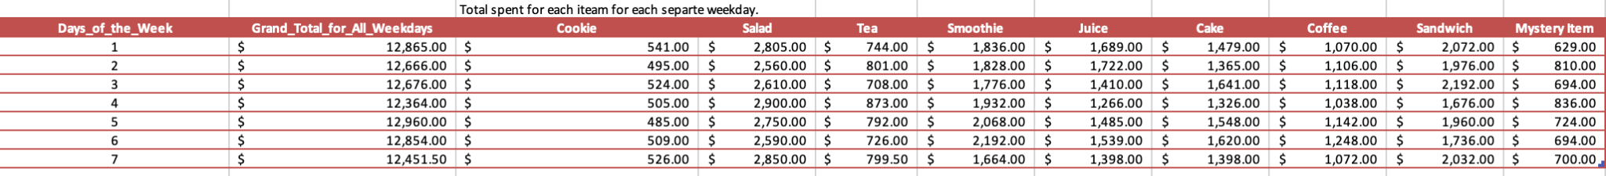
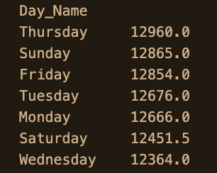
Revenue Breakdown by Day
Using Python and Excel, we analyzed revenue by day of the week.
We found that Thursday is the most profitable day for the café.
This insight can help with smarter planning — for example, launching new items or running promotions on Thursdays to take advantage of the higher customer traffic.
Notes:
Ayema speaks:
Using Python, I calculated how much revenue was made on each day of the week.
This helped us figure out which day brings in the most money overall.
What we found is that Thursday is the most profitable day, with the highest total sales compared to the rest of the week.
This could mean that customers are more likely to visit the café later in the week — maybe after work or before the weekend.
Itzel speaks:
** Adding on to the information my partner Ayema has presented, the chart above gives us a more in depth analysis to how much revenue each item contributed throughout the weekdays/weekends of the year 2023.
** Because We can view which item is sold within the day of Thursday, we could use that insight to launch new products or promotions on that day. This helps boost product popularity and take advantage of higher traffic

Slide 10
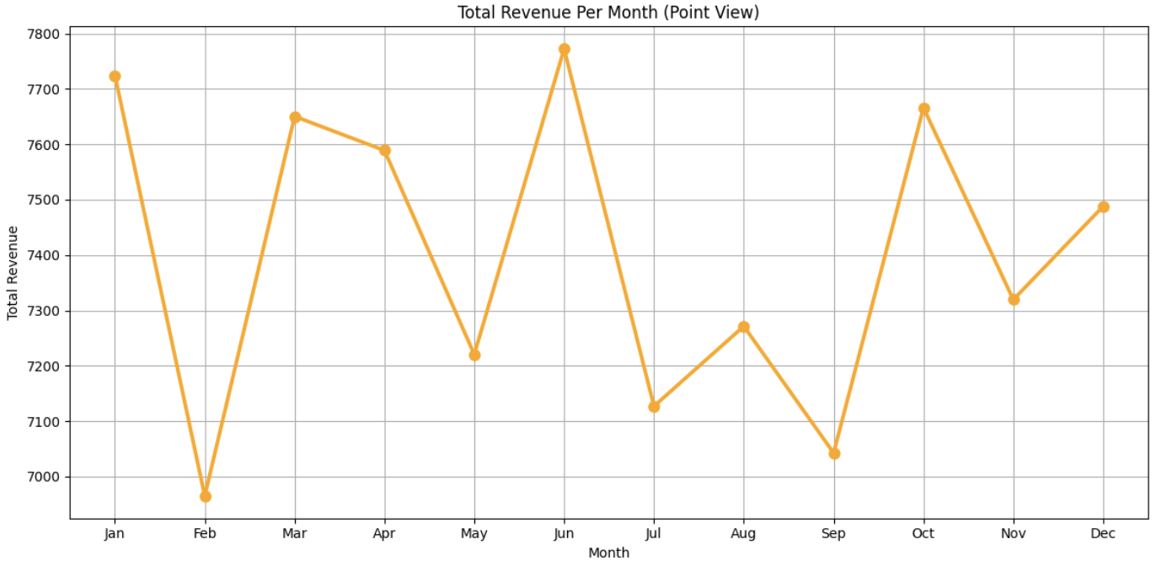

Monthly Revenue Trends
What this chart tells us:
June was the highest-earning month
February had the lowest revenue
We suggest
Running seasonal promotions (e.g. Valentines deals in February)
Creating Bundle offers (e.g. coffee + pastry)
Using social media to boost traffic during slower months
Date
Notes:
This line chart shows how much revenue the café made each month. One of the first things we noticed is that June was the most profitable month, meaning something likely worked well during that time — like a good promotion, event, or product lineup.
On the other hand, February had the lowest revenue, suggesting fewer customers or slower business. We also saw smaller dips throughout the year — like between March and May, June and July, August to September, and October to November.
These patterns give us great insight. They show us when things slowed down, which means there's room for improvement during those months.
We recommend running seasonal promotions, offering bundle deals, and boosting social media marketing to attract more customers during those slower periods.
And for high-performing months like June — whatever was done during that time, we suggest the café continues or builds on that success.
** either leaning towards upcoming holidays, keeping track of environmental changes (ex: july -sep , sep -nov) can help better understand the interests an likes customers have

Slide 11
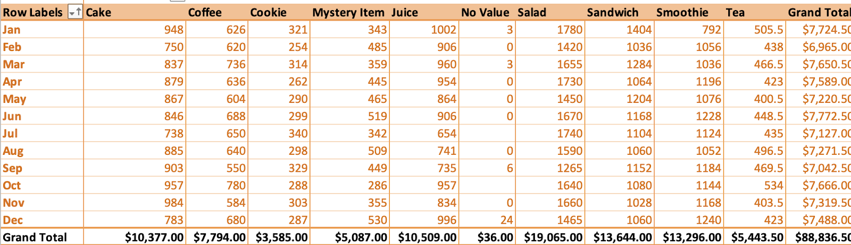
Notes:
This PivotTable was created in order to demonstrate which month brought in the most money.
** What we can view from this pivot table are the months that contributed to the highest earning to its lowest, as well as the items that contributed to its monthly revenue.
** This information can help determine which items are driving sales and which ones aren’t.
** Might be wondering what these Mystery_Item column means , well , not to get to technical yet referring to what i said before this 'Mystery Item' is used for when an item name was missing, yet we could still view how much was earned from that sale. ThisInstead of deleting that data, we kept it so that all profits were counted — even if the exact product wasn’t known.
If you look here, theres a mystery item column, which we talked about before in one of the steps.. Talk about mystery column…

Slide 12
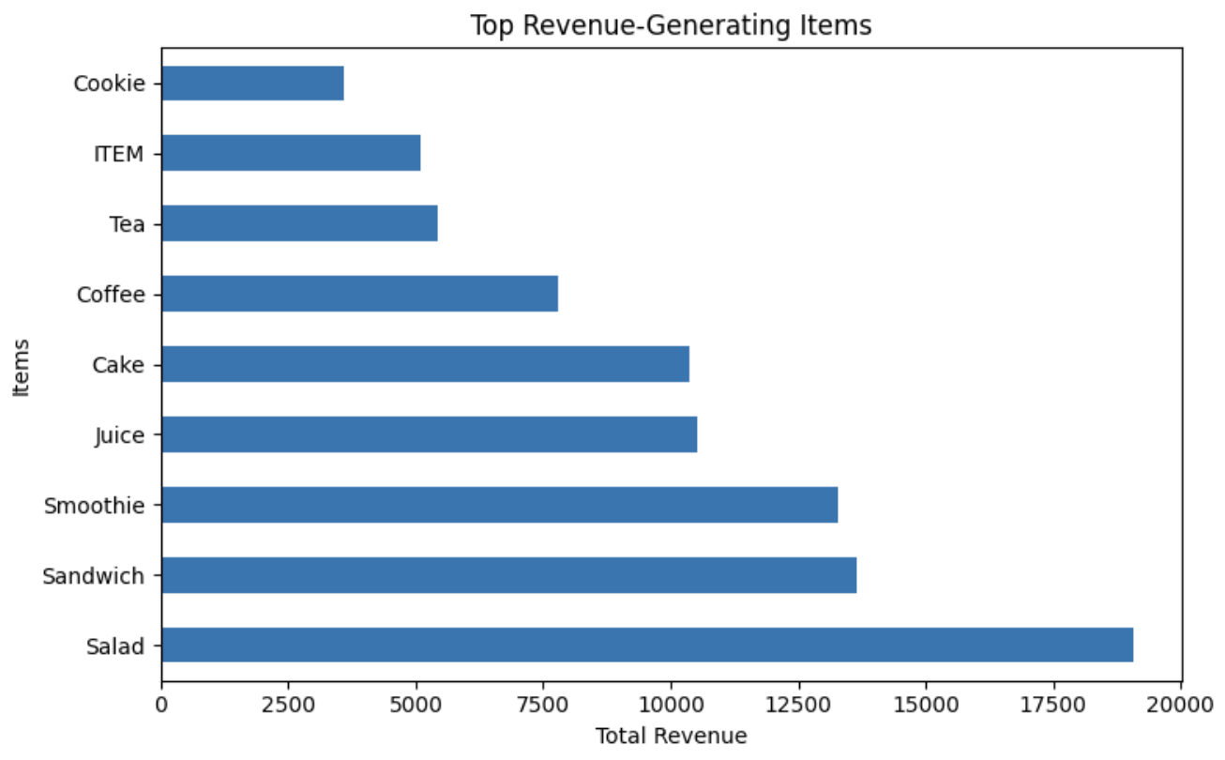
Item Revenue Breakdown
This chart shows which items made the most money.
Salads, sandwiches, and smoothies were the top sellers
Cookies and tea brought in the least.
This helps us see what’s working best on the menu
Notes:
So here’s a bar graph we made using Python to show how much money each item brought in overall. We arranged it from the least profitable to the most profitable, so it’s really easy to see what’s performing well.
As you can see, the top three items that brought in the most money were salads, sandwiches, and smoothies. These items made the highest revenue across the entire year. That’s a really helpful insight — it tells us what your customers are buying the most, and what’s making your business the most money.
Now, what can we do with this? If you know that salads and sandwiches are big sellers, you could try things like:
Promoting these items more often
Offering combo deals with drinks or snacks
Or even testing out seasonal versions — like a summer smoothie or a winter salad bowl.
By leaning into what’s already working, you can boost your profits without needing to change the whole menu. It’s all about doing more of what already brings in results.
Additionally, we noticed that coffee and tea aren’t selling as well as you’d expect in a typical café. It might be helpful to explore which specific types of tea or coffee customers prefer — this insight could guide you in offering a more appealing variety and boosting sales.
We hope this visual makes it easier to decide what to keep, promote, or maybe even expand in the future

Slide 13
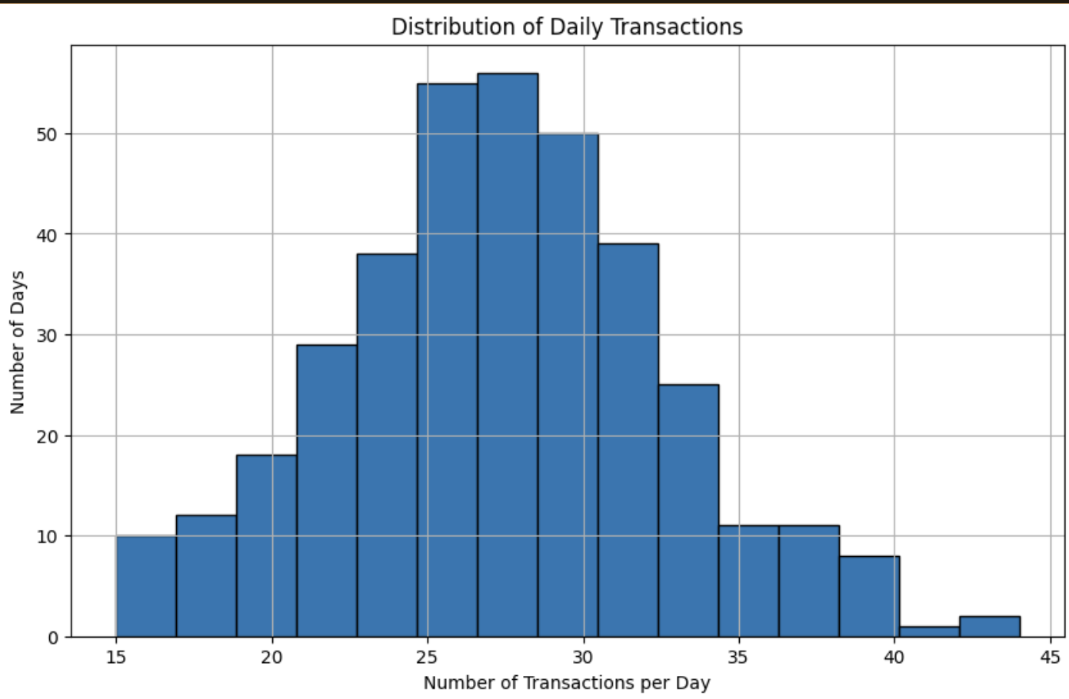
Understanding Our Daily Traffic
This helps us ask helpful questions like:
What's our typical number of sales per day?
Are we steady or unpredictable day to day?
Do we have any spikes or slow periods we should pay attention to?
Notes:
This bar graph is called a histogram, and it helps us understand how busy the café is on a typical day.
Each bar shows how many days had a certain number of transactions. For example, the tallest bar in the middle shows that on more than 50 days, the café had between 25 to 30 sales.
We can also spot any outliers, like the few days with 40–45 sales, which might have been special events or unusually busy days.
Overall, This bar graph is helpful because it shows us what a typical day looks like for the café — how many sales we usually get, how consistent business is, and whether there are any unusually busy or slow days.

Slide 14
Recommendations
Notes:
Itzel introduce this slide

Slide 15
Recommendations
Improvement on transaction data
Track Time of Day for Transaction
Recording how and where each sale happens (like in-store vs. online or cash vs. card) can help improve marketing strategies and prevent lost sales data. It also gives clearer insights into customer behavior and payment trends.
Daily item tracking helps improve low sellers with deals and reveals what new products to offer based on demand.
Improvement of Inventory (Products)
Create Product Bundles
Daily item tracking helps improve low sellers with deals and reveals what new products to offer based on demand.
Turn common pairings (like tea + cookies or sandwich + drink) into combos to boost sales and move slower items
Notes:
Improvement on transaction data: Another improvement we recommend is recording more details about each transaction — like whether it happened in-store or online, and whether the customer paid with cash, card, or something else.
This matters because it helps you understand your customers better. For example, if most people order online, you could focus more on promoting delivery or pickup deals. If most people pay in cash, maybe look at loyalty cards or in-store promotions.
It’s also important from a safety and financial perspective. Missing transaction info — especially about payment types — could mean lost revenue or errors in your records. So tracking this properly can help keep things both efficient and secure.
Improvement of inventory(products): Keeping track of daily product sales helps identify which items are doing well and which ones might need a boost. This can guide decisions around discounts, deals, or even introducing new menu items based on what customers actually buy.
Track the Time of Day for Each Transaction: Right now, the data shows the date of each sale but not the exact time. If you start tracking the time of each sale, we can figure out which hours of the day are the busiest — like the morning rush or slow afternoons. This can help you decide when to schedule more staff or when to run special promotions.
Create Product Bundles: One opportunity we found is to create product bundles based on common purchases — like tea and cookies, or a sandwich with a drink. These combinations are already being bought together, so turning them into official deals like a ‘Meal Combo’ or ‘Afternoon Treat’ could encourage customers to spend a little more. It’s also a great way to boost sales of items that don’t sell as well on their own.

Slide 16
THANK
YOU!
Thank you for taking the time to review our work. We hope these insights support the continued success of your café.
CONTACT OUR TEAM
Goated_team@gmail.com

Slide 17
Reflections
Navigating GitHub and Version Control
Communicating Our Thought Processes
Keeping Each Other Accountable
Faced merge conflicts when working at the same time
Learned to communicate better and write clear commit messages
Developed a smoother workflow to avoid overwriting work
Took time to explain technical steps clearly
Realized we’re both visual learners
Used diagrams, writing, and examples to stay aligned
Cross-checked Excel and Python results
Caught errors through comparison
Built trust and confidence in our final analysis
Notes:
In the beginning of our project, GitHub was definitely one of our biggest challenges. When both of us worked on the same files at the same time, we often ran into merge conflicts or issues where GitHub didn’t know which version to keep. This caused delays and confusion.
But over time, we learned how to handle it. We got better at communicating—letting each other know when we were working on certain files—and started writing clear commit messages. We also developed a simple workflow that helped us avoid overwriting each other’s progress. By the end, we were much more confident using GitHub as a team.
Another big challenge was clearly explaining our ideas to each other. At first, it sometimes took multiple tries to get our points across—especially when we were talking about formulas, cleaning steps, or anything technical.
Eventually, we realized that we’re both visual learners. So instead of just talking it out, we started writing things down, sketching out ideas, or showing examples. This made a huge difference and helped us stay on the same page throughout the project.
One of the most important things we did was hold each other accountable. If one of us got a result in Excel, the other would try to get the same answer in Python. At first, this was frustrating—especially when our results didn’t match. It made us question who was right or if there was an error in our process.
But over time, we realized this was actually a strength. These double checks helped us catch mistakes, fix them early, and feel more confident about the accuracy of our work. It turned out to be one of the best decisions we made on this project.

